Slide 1
Contracts
Francesco Logozzo
Microsoft Research, Redmond

Slide 2
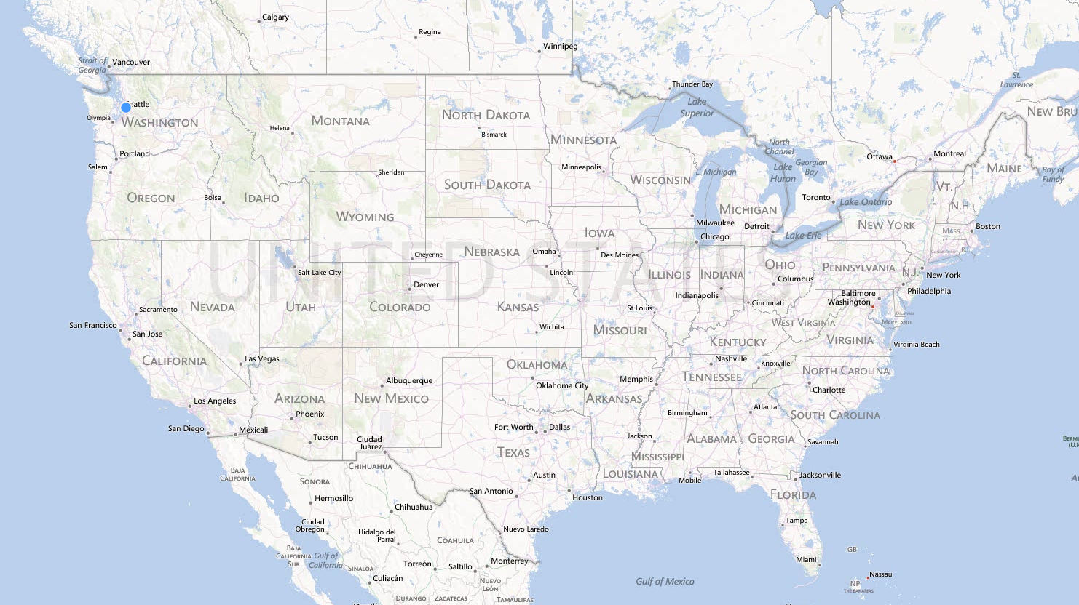
Redmond?

Slide 3
(Informal) introduction

Slide 4
What is programming about?
Just writing code!
How?
Learn a programming language
and libraries
Learn the tools
IDE, compiler, debugger …
Hack some code
Compile, run, execute &…Crash!!!!

Slide 5
What is a crash?
What it means the program “crashes”?
Segmentation fault
Null pointer exception
Division by zero
Index out of bounds
Out of memory
….
All just the manifestation of something else…

Slide 6
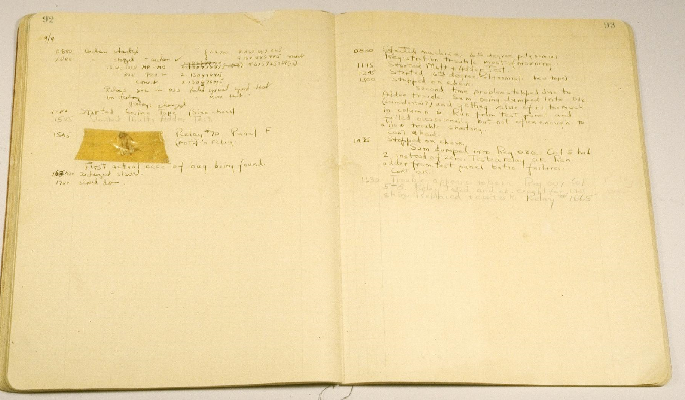
Bugs!
But what is a crash really?
Just the manifestation of a bug
And what is a bug?
"...traced an error in the Mark II to a moth trapped in a relay. The bug was carefully removed and taped to a daily log book. Since then, whenever a computer has a problem, it's referred to as a bug."
Grace Hopper, 1947
BTW, who knows who G. Hopper is?

Slide 7
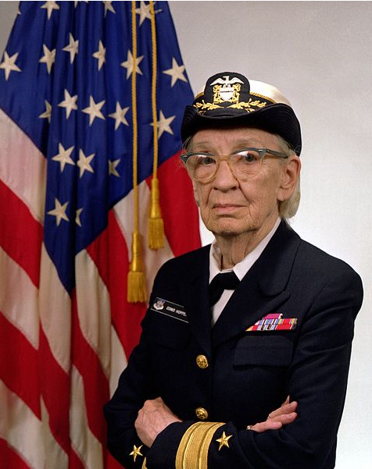
Grace Hopper
Ph.D. in Math from Yale
Developed first compiler ever
Conceptualized machine-independent languages
Led to development of COBOL
Created the term “debugging”
Rear-Admiral of USA Navy

Slide 8
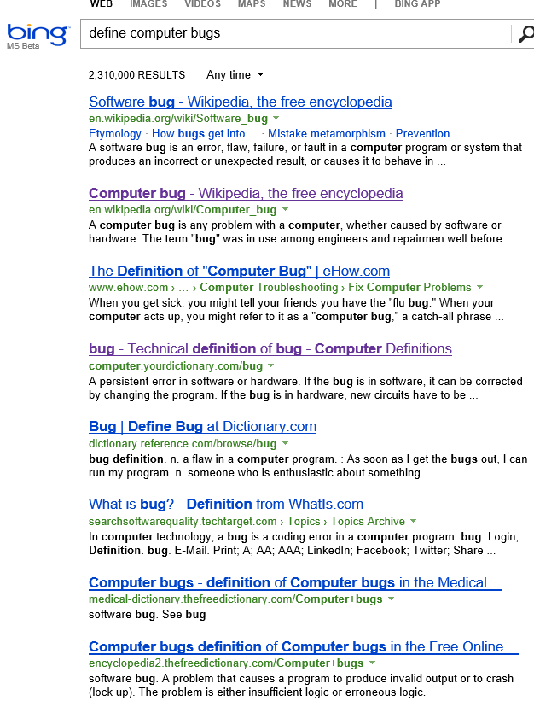
So, bugs…

Slide 9
Unexpected result?
Behind any programming activity there is an expectation
What the program should do
Sort an array, find the maximum …
What the program should not do
Read private data, divide by zero …
Loop forever, Irresponsive UI …
The expectation is the program specification

Slide 10
What is programming about?
Specification
What my code should do and should not do
Hacking
Write the code
Debugging/Verifying
“Prove” my code follows its specification

Slide 11

Hacking
You saw it in other classes

Slide 12
Specification
What this class is about
Can be informal
No hang, no infinite loops, no crashes, no wrong output …
Can be formal
Simplest: Test cases
What I expect in some finite cases
More complex: Formal specification language

Slide 13
Debugging/Verifying
Very little in this class
Essentially the main ideas
Runtime analysis
Run the program, observe the behavior for some specific runs
Check if the behavior violates the specification
Static analysis/verification
Do not run the program, observe the properties for all runs
Check if the behavior meets the specification

Slide 14
Demo!!!!

Slide 15
So, specification…
How do we specify what a program should do?
We need to fix a language
First example: Types
foo: int -> int
Specifies that foo takes an int and returns an int
Ignores non-termination
Ex: foo(x) = foo(x-1)

Slide 16
Example: Abs
Which is the specification for this code?
Reminder:
-(-2³¹)== -2³¹
public int Abs(int x)
{
if (x < 0)
return -x;
else
return x;
}
Notes:
Two choices here:
Pre: true
Post: x >= 0 || x == int.MinValue
Or
Pre: x != Int.MinValue
Post: x >= 0

Slide 17
Some specification languages
UML
Temporal logic
Z/B notations
Abstract State Machines/TLA+
Contracts CodeContracts
SAL
….
Implementation!

Slide 18
The art of specification
There is a tradeoff between the expressive power and the “usefulness”
Reference
implementation
temporal
logic
…
contracts
types
Expressive
Useful

Slide 19
Trades-off
Design a specification language
Expressive enough to express interesting properties
What it means “interesting?”
Useful
What’s useful?
Easy to understand
Does not require a Ph.D. in Logics to read/write specifications

Slide 20
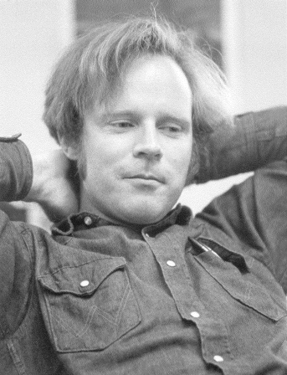
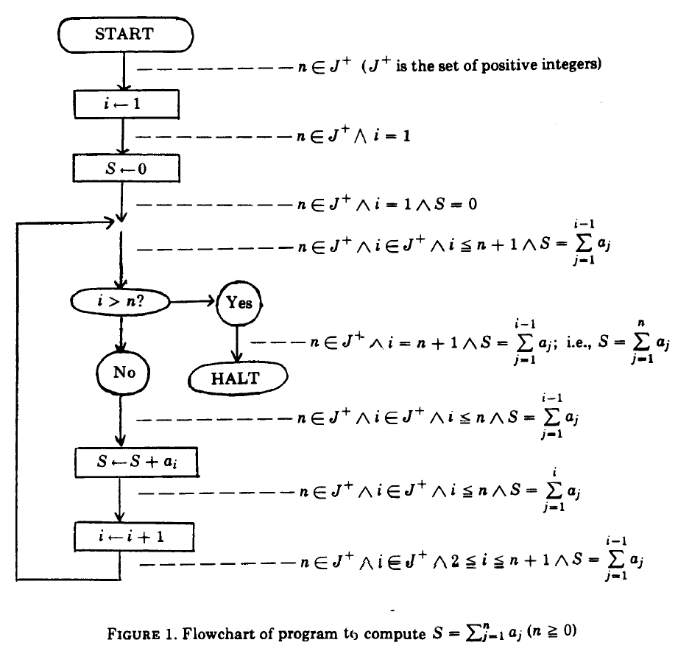
Some history, Assertions
Robert W. Floyd
Computer pioneer, Turing Award winner
“Assigning meaning to programs”, 1967
Attach a predicate to each program
point
First correctness proofs
Safety
Termination
Program equivalence
Precondition
Postcondition

Slide 21
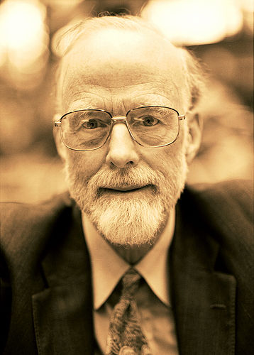
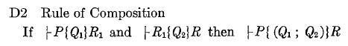
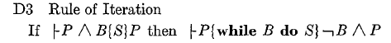
Hoare Logic
C.A.R. Hoare
Computer pioneer, Turing Award winner
“An Axiomatic Basis for Computer Programming”, 1969
Axioms and rules to reason on programs
Assertions before and after each statement (pre- and post-conditions)

Slide 22
Assertions & specification
Simple form of specification
“We want this to hold at this program point”
Implicit assertions, Induced by the language
Null pointers, array out of bounds in C# or Java
But not in C/C++!
Explicit assertions, denoted by programmers
assert keyword in Java
ASSERT() macro in C
Debug.Assert in C#

Slide 23
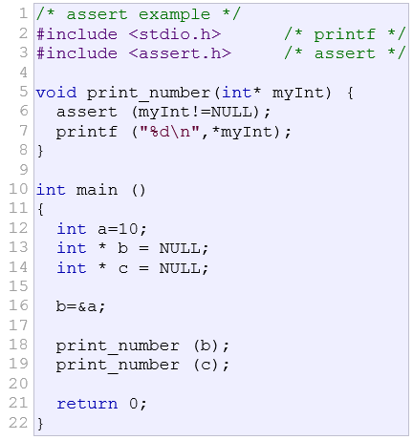
Example

Slide 24
Assertions
What should hold at a given program point
Floyd’s Idea
Check them at runtime
If an assertion is violated, stop execution
Make code more robust:
“ … with an increase in the assertion density there is a decrease in the fault density and vice versa.”
G. Kudrjavets, N. Nagappan, T. Ball

Slide 25
Contracts: Assertions on steroids?
Very popular in industrial-level programming
Simple idea:
Precondition
What you expect from callers
Postcondition
What you guarantee to callers
Object invariant
What holds in the steady states of the object
What is a steady state?

Slide 26

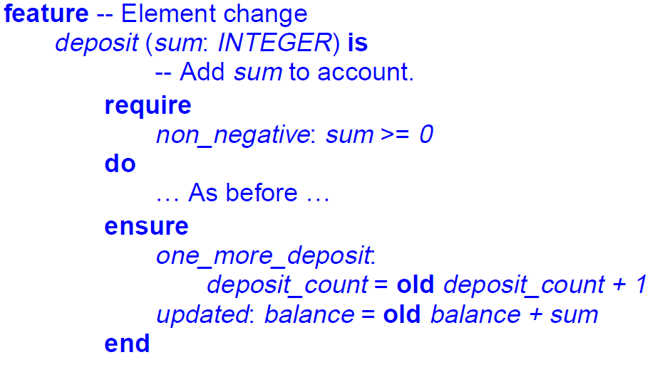
Some history: Contracts
B. Meyer
Designer of the Eiffel programming language
Object-Oriented software construction, 1988
Eiffel provides first class support to contracts

Slide 27
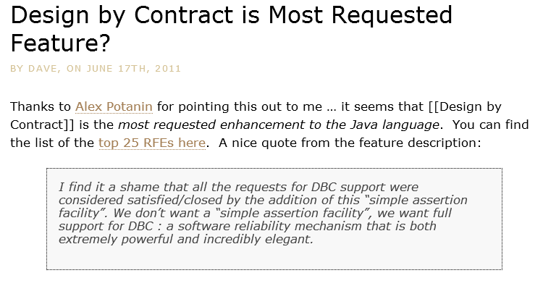
Why Contracts?
We have assert, why do we need contracts?

Slide 28
Brainstorming…

Slide 29
Our C Example
assert not visible!

Slide 30
Exceptions
Use exceptions for parameter validation:
Popular in Java APIs to protect from unwanted values
Problem: not visible to callers
Exceptions are not errors!!!!
E.g., use them to go out of a deep recursion
static public int GCD(int x, int y)
{
if (x < 0)
throw new ArgumentException("Error");
…
}

Slide 31
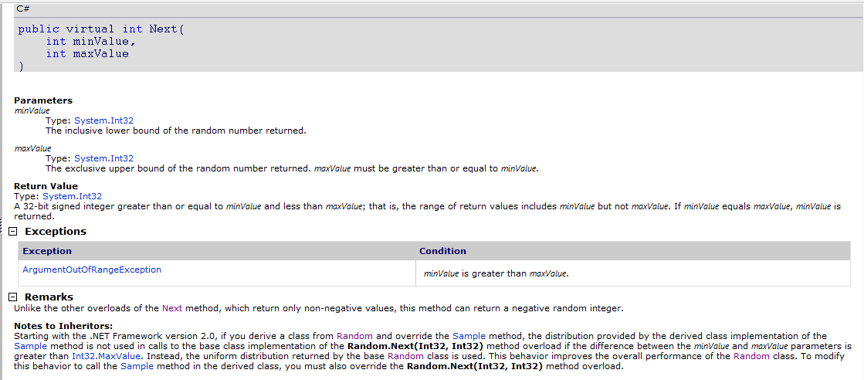
Example: MSDN
Precondition
Postcondition

Slide 32
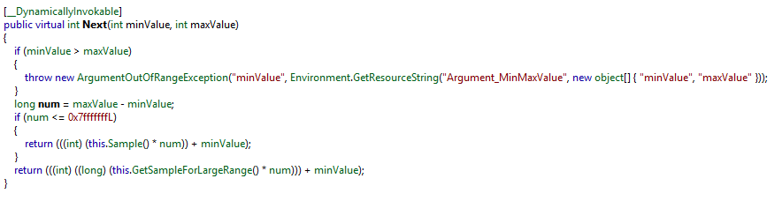
Code/Documentation Sync

Slide 33
Postconditions
static public int GCD(int x, int y)
{
Debug.Assert(x > 0);
Debug.Assert(y > 0);
while (true)
if (x < y) { y %= x; if (y == 0) return x; }
else { x %= y; if (x == 0) return y; }
}
Debug.Assert(Result > 0) ?

Slide 34
Object oriented programming
Inheritance
Weaker precondition
Should be called in more contexts
Stronger postcondition
Can give more guarantees
Example: ToString() never returns null
How to enforce it to all the implementors?

Slide 35
Object oriented programming, cntd.
Object invariants
Valid in steady states
Intuitively before and after every public method call
Ex. this.x != null
Should I add it to every method
Interfaces, abstract methods
Where should I put my asserts?

Slide 36
Devil’s advocate
So Contracts are good for documentation
Can generate documentation automatically
Are they good for programmers?
“My Java/C# program has already implicit asserts: So the program will eventually fail”
Why should we check it twice???
public int Foo(int[] arr)
{
return FooInternal(arr);
}
private int FooInternal(int[] arr)
{
return arr[0];
}

Slide 37
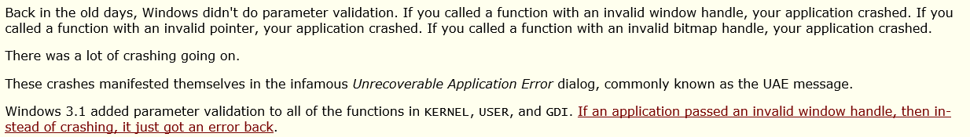
Some history, parameter validation
In C++, STL does not perform parameter validation
No check on arguments to avoid double testing
Performances…
Contracts enable early bug detection
Modern APIs all perform parameter validation (using Contracts when available)

Slide 38
Modular reasoning
Module
A
Module
B

Slide 39
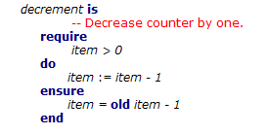
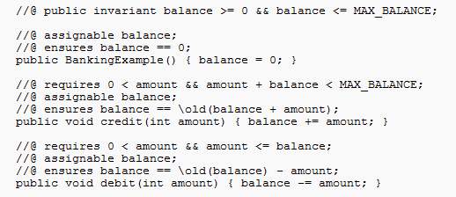
Contracts & Languages
First class citizens in many languages
Eiffel, Ada Spark, Spec#, D …
Provide syntax to specify them
Special encoding in others
JML, CodeContracts …

Slide 40
Reality check
There is a general consensus on Contracts
Never met someone saying “they are bad”
Unlike types
Ex. JavaScript, PHP, Python, Perl …
Why not everyone are using them?
Ideas?

Slide 41
Reality
Eiffel, Ada Spark are “niche” languages
New syntax, libraries, tools etc.
Few people use it
Banks, Aerospace
Very few available programmers
Industry does not want to use “research compilers”
Reliability, performance, etc.
No changes to the build routine

Slide 42
CodeContracts
Contracts for the working programmer

Slide 43
Contracts in comments? In attributes?
Good
Regular compiler ignores them
Production bits uneffected
Bad
Regular compiler ignores them
Runtime checking?
Parsing, type checking, name resolution…
Serialization? Persistence?

Slide 44
Attributes
Like Eclipse
Two choices
Use strings
Need parsing, etc.
Use trees
Impossible to read, write
Not extensible
[ContractPre(“x ≥ 0”)]
protected void foo(int x) { … }
[ContractPre(Geq(Var(“x”), Const(typeof(int), 0))]
protected void foo(int x) { … }

Slide 45
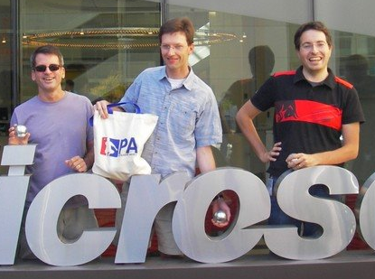
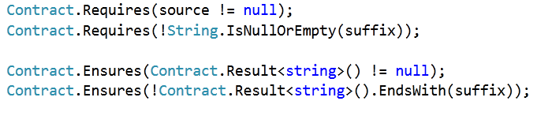
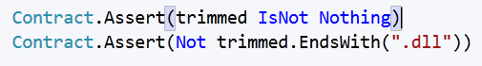
CodeContracts
Idea: Use the code to specify code
Static methods in a Contract type
Language agnostic: Same for C#, VB, F# …
Standard in .NET since v4.0

Slide 46

The good
No language support
Only static method calls
compilers know how to emit code for them
No semantic issues
Semantics given by the compiler
// Increments parameter by one
public int Incr(int x)
{
return x + 1;
}

Slide 47
The good, cntd
Uniform serialization format
IL, intermediate code produced by all .NET compilers
Cross language
Exploit .NET type system
Understood by all tools
Each production group used to have their assertion/contract language
For free IDE support
Colorization, indentation …
Type checking
Intellisense

Slide 48
Preconditions
int foo(String s, int y)
{
Contract.Requires(s != null);
Contract.Requires(y > 0);
// ...
}
C# expressions

Slide 49
Preconditions
Public Function foo(ByVal s As String, ByVal y As Integer)
As Integer
Contract.Requires(s IsNot Nothing)
Contract.Requires(y > 0)
‘ …
End Function
VB expressions
Int32 __gc* foo(String __gc* s, Int32 __gc* y)
{
Contract::Requires(s != 0);
Contract::Requires(y > 0);
C++ expressions

Slide 50
Hmmmm…..
Am I missing something?
Too beautiful to be true?
Ideas????

Slide 51
Side effects!
public class SideEffect
{
int x;
public void foo(SideEffect se)
{
Contract.Requires(XPositive());
//…
}
public bool XPositive()
{
return this.x > 0;
}
public bool XPositive()
{
int oldx = this.x;
this.x = -this.x;
return oldx > 0;
}
Change the state

Slide 52
Purity
Contracts turn out to be not so simple…
Contracts should be pure
The evaluation
What is purity?
Define it!

Slide 53
CodeContracts & Purity
Agnostic approach
Method calls appearing in contracts should be marked with [Pure]
User takes responsibility
Brainstorming: How do we check purity?
Runtime?
Static time?

Slide 54
Postconditions
Class Field
{
int x;
int Set(int y)
{
Contract.Ensures(this.x == y);
this.x = y;
}
}

Slide 55
Result value?
We’d like to express something about the value returned by a method
Non-negative, larger than the input, etc.
public int Fact(int x)
{
Contract.Ensures(Contract.Result<int>() >= 0); …
}

Slide 56
Question
Why <int> or <bool> ???
public int Fact(int x)
{
Contract.Ensures(Contract.Result<int>() >= 0); …
}
public bool[] ArrayFactory(int x)
{
Contract.Ensures(Contract.Result<bool[]>() != null); return new bool[x];
}
T Contract.Result<T>()

Slide 57
Old value
We’d like to express relations between the entry and the exit state of the method
Ex. Incremented by one
Class Account
{
int balance;
int Add(int k)
{
Contract.Ensures(this.balance == Contract.Old(this.balance) + k);
this.balance += k;
}
}
T Contract.Old<T>(T value)

Slide 58
Quantifiers
Limited form
Contract.ForAll(0, a.Length, j => a[j] > 0)
Contract.Exists (0, a.Length, j => a[j] > 0)
Exploit higher order functions in C#
Question: why?
Can we extend them?
How?

Slide 59
Loop invariants?

Slide 60
Object invariants
Class Account
{
int balance;
[ContractInvariantMethod]
protected void ObjectInvariant()
{
Contract.Invariant(balance >= 0);
}
}

Slide 61
Object invariants…
class Class1
{
private readonly Dictionary<string, int[]> validators;
[ContractInvariantMethod]
private void Invariants()
{
Contract.Invariant(validators != null);
}
public Class1()
{
Test();
}
[Pure]
public void Test()
{
}
}

Slide 62
Interfaces
[ContractClass(typeof(WithdrawContracts))]
interface IWithdraw
{
long Balance { get; }
void Withdraw(long money);
}
[ContractClassFor(typeof(IWithdraw))]
public class WithdrawContracts : IWithdraw {
public long Balance { get { Contract.Ensures(Contract.Result<long>() >= 0); return -111; } }
public void Withdraw(long money) {
Contract.Requires(money < this.Balance);}}

Slide 63
More…
public void SetRefParam(out int x)
{
Contract.Ensures(Contract.ValueAtReturn(out x) == 12);
x = 12;
}
Abstract classes
Similar to interfaces
out/ref parameters
Use dummy methods as for Old
Legacy code
public int Foo(int[] arr)
{
if (arr == null)
throw new ArgumentNullException();
Contract.EndContractBlock();
…
}

Slide 64
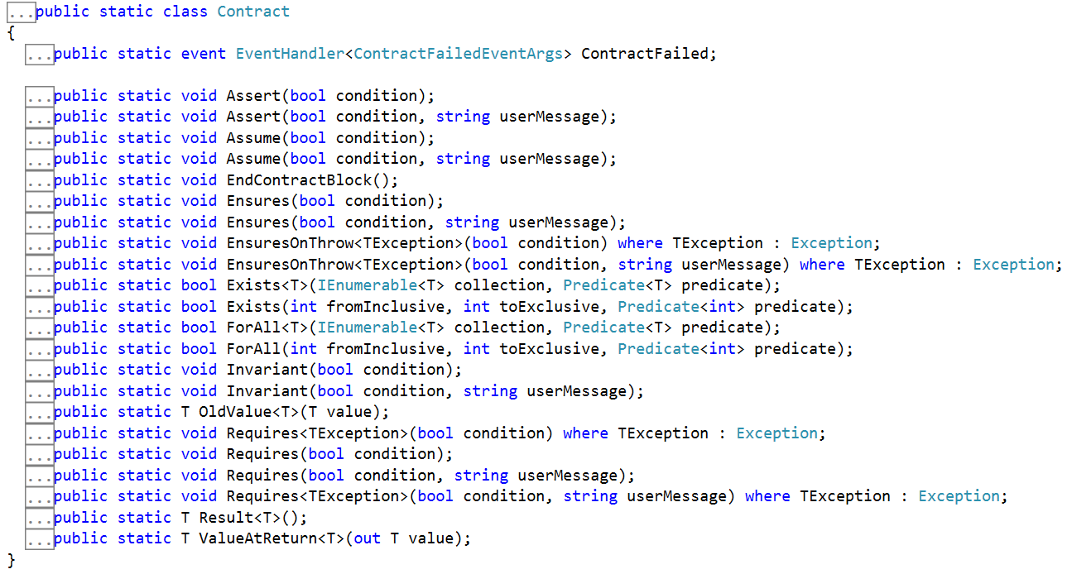
From .NET core

Slide 65
Semantics!
What Contracts really mean?

Slide 66
Our toy language
Syntax
Simple while language
C = skip; | C;C | if(e) C else C | while(e) C | x = e;
E = k | v | E bop E | uop E
Easy to extend to function call
If assume no global variables

Slide 67
Concrete semantics
A state maps variables to values
Σ = [V → Z]
A program property is a subset of Σ
P = ℘(Σ)
The strongest program property is the semantics
C ⟦P⟧ = { ⟦P⟧ }

Slide 68
Example
Σ
{ σ ∈ Σ | σ(x) ≥ -15 }
x = 12;
x = x + 3;
{ σ ∈ Σ | σ(x) ≥ 0 }
{ σ ∈ Σ | σ(x) = 15 ∨ σ(x) = 5}
{ σ ∈ Σ | σ(x) = 15 ∨ σ(x) = 27}
{ σ ∈ Σ | σ(x) = 15 }

Slide 69
Program properties
They form a complete lattice
〈℘(Σ), ⊆, ∪, ∩, ⊥, ⊤〉
The lower in the lattice, the more precise the information
Idea: Properties are the best specifications
Precondition: ℘(Σ)
Postcondition: ℘(Σ x Σ)
Should relate input and output

Slide 70
Example
Ignore integer overflows
Precondition: Σ
x = x + 1;
Postcondition: { 〈σ, σ’〉 | σ(x) = σ’(x)-1 }

Slide 71
Algebraic Hoare Logic
Specify program with sets of states
Provide axiomatic rules to reason on the specification
Think of it as well-formed specifications
Not tied to a particular specification language
The specification language is just an abstraction
1st order logic, separation logic, etc.
We will see it later
Define rules by induction on the program syntax

Slide 72
Axioms
∀ P, Q ∈ ℘(Σ)
{ ∅ } C { P }
{ P } C { Σ }
{ P } skip { P }
{ P } assert e { { σ ∈ P | ⟦e⟧σ = true } }
{ P } x = e { { σ ∈ P | σ’ = σ[x ↦ ⟦e⟧ } }

Slide 73
Deductive Rules
{ P } C₁ { S } { S } C₂ { Q }
{ P } C₁; C₂ { Q }
{ P ∩ ⟦e⟧ (P) } C₁ { Q₁ } {P ∩ ⟦!e⟧ (P) } C₂ { Q₂ }
{ P } if(e) C₁ else C₂ { Q₁∪ Q₂ }
P ⊆ I
J ⊆ I
{ I ∩ ⟦e⟧ (P)} S { J }
I ∩ ⟦!e⟧ (P) ⊆ Q
{ P } while (e) C { Q }

Slide 74
Consequence Rules
P ⊆ P’ { P’ } C { Q’ } Q’ ⊆ Q
{ P } C { Q }
{ P₁ } C { Q₁ } { P₂ } C { Q₂ }
{P₁ ∪ P₂ } C {Q₁ ∪ Q₂ }
{ P₁ } C { Q₁ } { P₂ } C { Q₂ }
{P₁ ∩ P₂ } C {Q₁ ∩ Q₂ }

Slide 75
Valid contracts
A contract P, Q ∈ ℘(Σ) × ℘(Σ)
is valid for C iff {P} C {Q}
Example: {Σ} C {Σ}
Some specification methods use sets
Z, B method, TLA+
Problems?
Sets are not computer-representable
Solution?
Perform abstraction!

Slide 76
Contracts specification language
Define a language L to express our contracts
L is generated by some grammar
Questions:
How many words are in L?
How many concrete properties we have?

Slide 77
Consequences?
All contract languages, and in general specification languages, are incomplete
A particular language can capture only a subset of the properties
There will always be some concrete property you cannot specify
Example: First order logic
Cannot express only reachability, the relation of equality, natural numbers …
Compactness theorem

Slide 78
Abstraction
Our contract language L represents some concrete properties
How to formalize it?
First, let’s put some constraints on L
Should express truth
true ∈ L
Should express falsehood
false ∈ L
Should express precision
⇒ ∈ L
Ex. false ⇒ true

Slide 79
Logic
Our language L is a logic, with false, true, ⇒
In general L can be seen as a partial order with bottom, top
∀ p, q ∈ L
p ⇒ p
If p ⇒ q and q ⇒ p then p = q
If p⇒ q’ and q’ ⇒ q then p ⇒ q
false ⇒ p
p ⇒ true
if p ⇒ false then p = false
if true ⇒ p then p = true

Slide 80
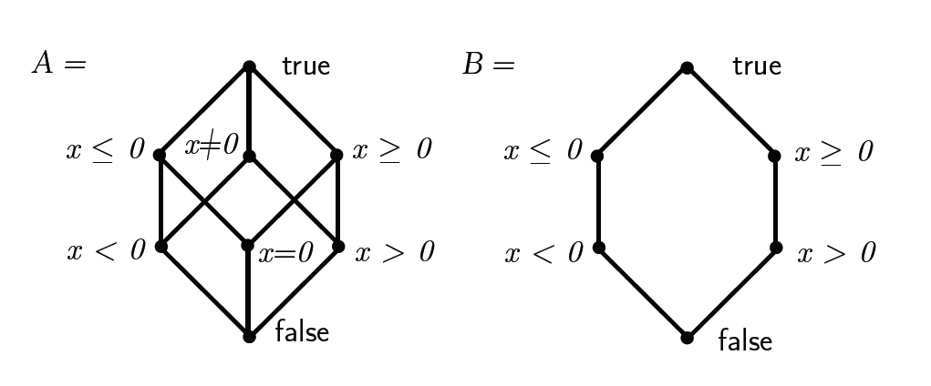
Logic, contract language
In general it is a partial order 〈L, ⇒, ∨, ∧ , false, true〉
Examples

Slide 81
Model/Semantics of the Logic?
Give meaning to formulas
Relate them to concrete properties
Via a concretization function γ
γ ∈ L → ℘(Σ)
Properties per γ?
γ(false) = ∅
γ(true) = Σ
What about p ⇒ q?

Slide 82
Concretization
Intuition ⇒ expresses the amount of information we have
Concretization should preserve the information
No miracles!
Therefore concretization should be monotonic
If p ⇒ q then γ(p) ⊆ γ(q)
What about the converse?
If P ⊆ Q then … ?

Slide 83
Consequences of monotonicity
Exercise: Prove those two identities
γ(p) ∪ γ(q) ⊆ γ(p ∨ q)
γ(p ∧ q) ⊆ γ(p) ∩ γ(q)

Slide 84
Effective contracts
Given a contract language L and two formula p, q in L
We say that p, q is a valid contract for C iff
{ γ(p) } C { γ(q) }
And we can define the validity in the abstract
{ p } C { q } ⇔ { γ(p) } C { γ(q) }
Idea:
Replace all the concrete rules with abstract ones

Slide 85
Axioms
{ false } C { p }
{ p } C { true }
{ p } skip { p }
{ p } assert e {p ∧ q }
{ p[x ↦ e] } x = e { p }

Slide 86
Deductive Rules
{ p } C₁ { s } { s } C₂ { q }
Extra hypotheses on L
Should have negation ¬
Otherwise?
{ p } C₁; C₂ { q }
{ p ∧ e } C₁ { q₁ } {p ∧ ¬e } C₂ { q₂ }
{ P } if(e) C₁ else C₂ { q₁∨ q₂ }
p ⇒ inv
j ⇒ inv
{ inv ∧ e } S { j }
I ∧ ¬e ⇒ q
{ p } while (e) C { q }

Slide 87
Consequence Rules
p ⇒ p’ { p’ } C { q’ } q’ ⇒ q
{ p } C { q }
{ p₁ } C { q₁ } { p₂ } C { q₂ }
{ p₁ ∨ p₂ } C { q₁ ∨ q₂ }
Are those rules true?
Can we deduce something false using them?
{ p₁ } C { q₁ } { p₂ } C { q₂ }
{ p₁ ∧ p₂ } C {q₁ ∧ q₂ }

Slide 88
Counterexample: Disjunction
{ x > 0 } x=x*x { x > 0 } and { x < 0 } x = x*x { x > 0 }
{ x > 0 ∨ x < 0 } x = x*x { x > 0 ∨ x > 0}
{ true } x = x*x { x > 0 }

Slide 89
Problem?
The triple
{ true } x = x*x { x > 0 }
Is not valid!
We cannot deduce this
{ Σ } x = x*x { {σ ∣ σ(x) > 0} }
Therefore our system is unsound!
Deduce false things…
Similar example for conjunction rule

Slide 90
Where is the problem?
The hypotheses on the γ are too weak
Monotonicity is not enough for a sound and complete system
Two solutions
Get rid of the unsound rules
This is what Tony Hoare suggested
Strengthen the hypotheses on γ
This is what we did

Slide 91
Soundness
If γ preserves conjunctions and disjunctions, i.e.,
γ(p) ∪ γ(q) = γ(p ∨ q)
γ(p ∧ q) = γ(p) ∩ γ(q)
Then
{ p } C { q } ⇔ { γ(p) } C { γ(q) }
Is sound
Otherwise, we should remove
Conjunction rule, if γ does not preserve ∧
Disjunction rule, if γ does not preserve ∨

Slide 92
To sum up
Define concrete contracts
Preconditions, postconditions are properties
i.e., they are sets of states
We know what it means to be a valid concrete contract
{ P } C { Q }
We know how to fix a language L to describe abstract contracts
{ p } C { q } ⇔ { γ(p) } C { γ(q) }
Where L is a partial order: 〈L, ⇒, ∨, ∧ , false, true〉

Slide 93
Inference
How to make Contracts usable in practice

Slide 94
Perfect world
Programmers provide all the contracts for their code
We do not live in a perfect world

